Slide 1
Cells : The basis of Life

Slide 2
Lesson Objective
Identify what are cells and define Cell Theory.

Slide 3
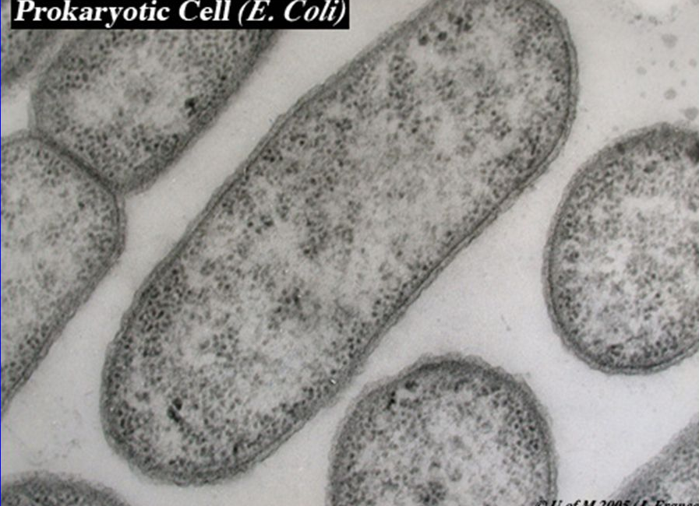
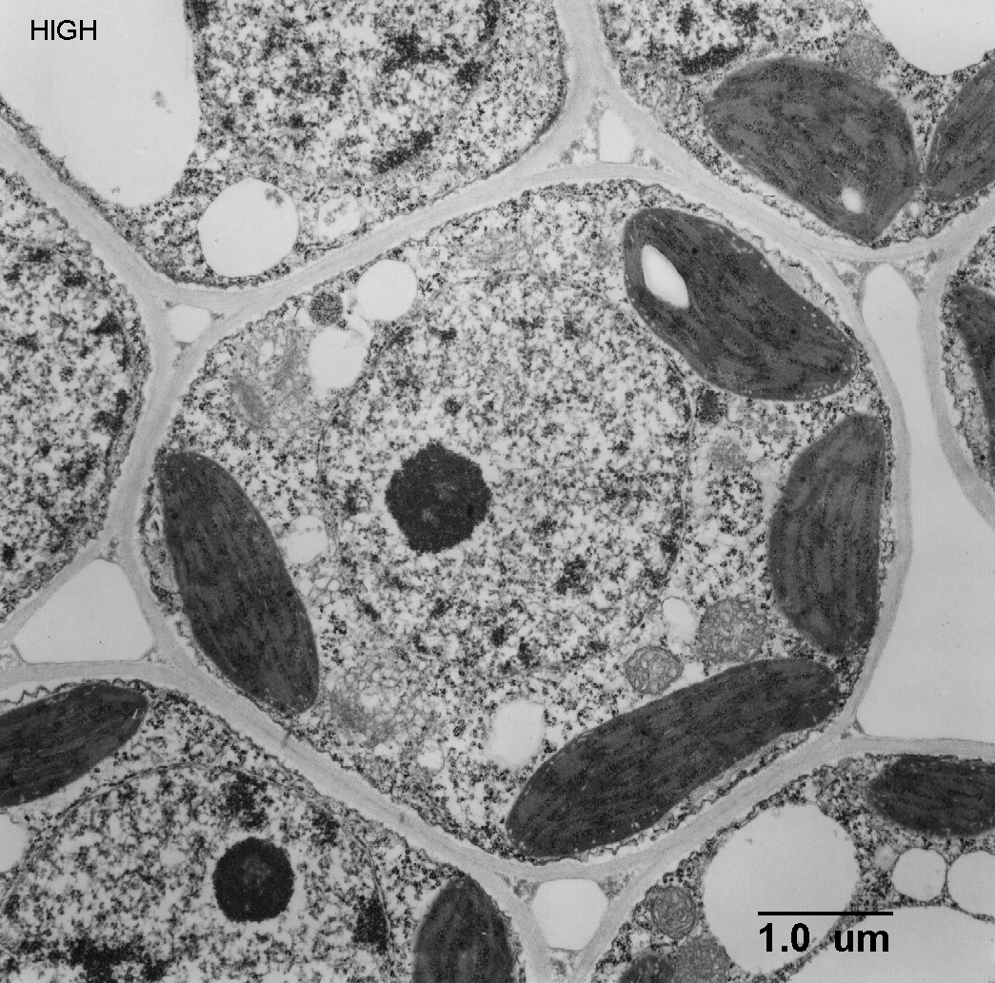
What can you observe are the main differences between the them?
Procaryotic Cell
Eukaryotic Cell

Slide 4
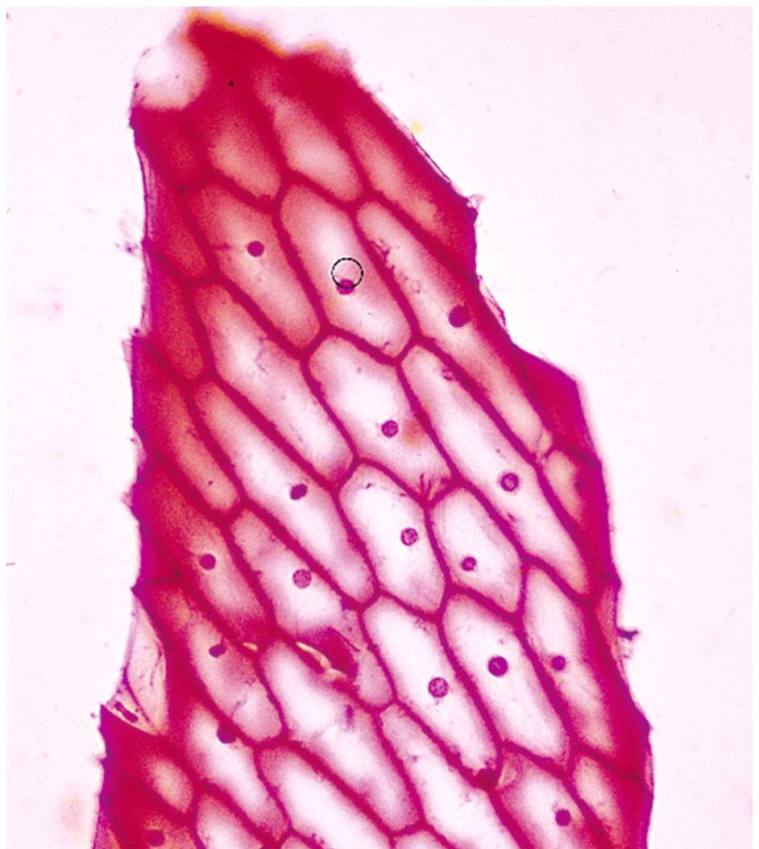
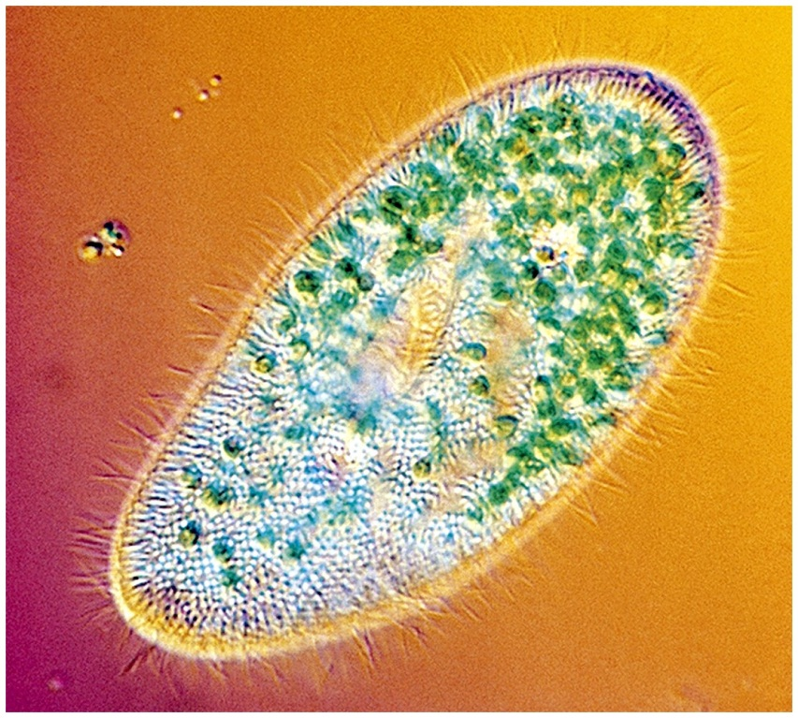
Three Principles of Cell Theory
The cell is the smallest unit of life that can live on is own.
This discovery was made possible only by the invention and development of the microscope.

Slide 5
Three Principles of Cell Theory
2. All living things are made of one or more cells.

Slide 6
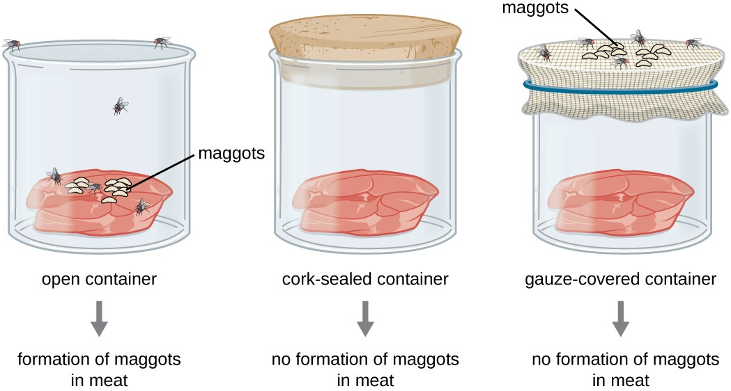
Three Principles of Cell Theory
3. All cells arise from preexisting cells. Life comes from Life.
The is no such thing as spontaneous generation.

Slide 7
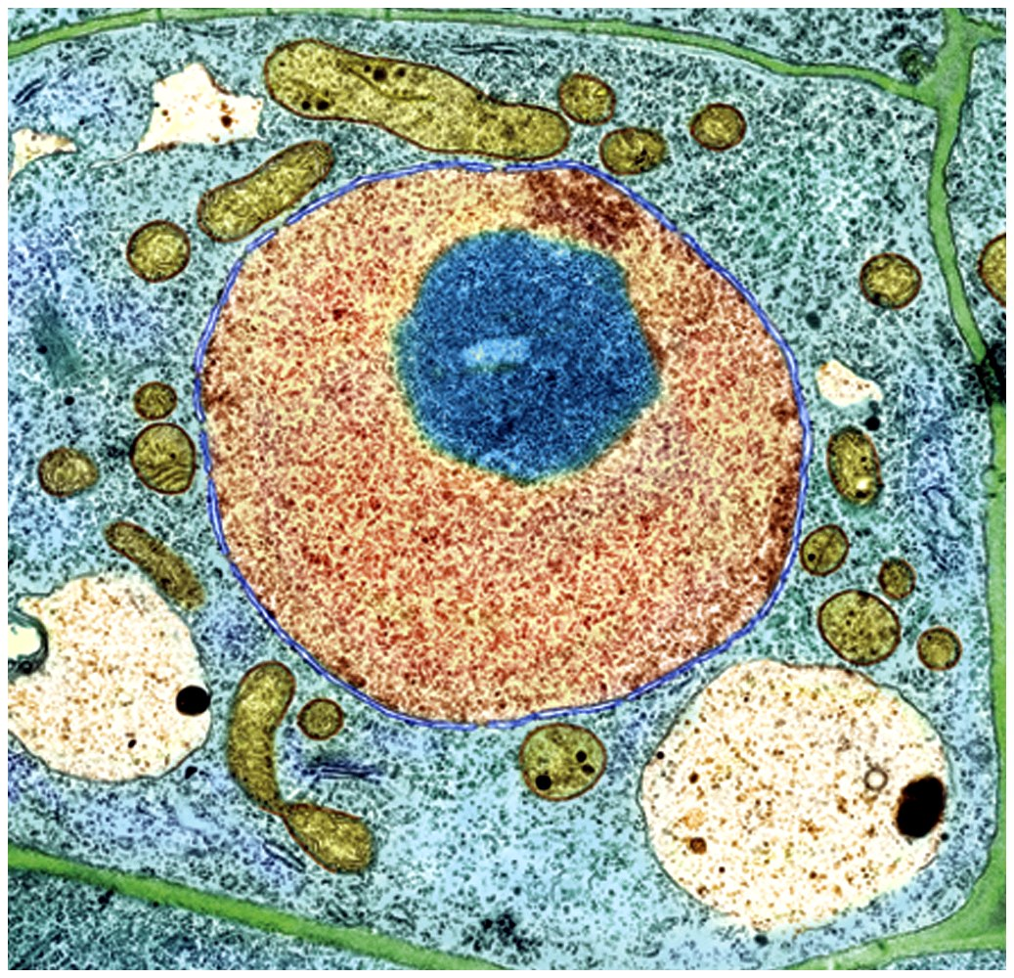
Cell Types
Prokaryotic
Eukaryotic

Slide 8
ICT
Create a list, table or draw a diagram highlighting some of the differences between procaryotic and eucaryotic cells.

Slide 9
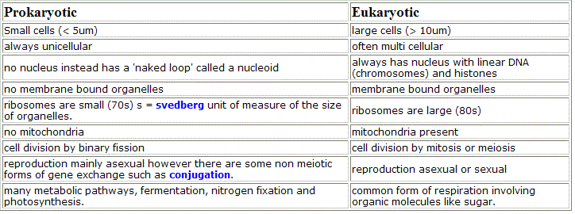
Differences and comparisons table

Slide 10
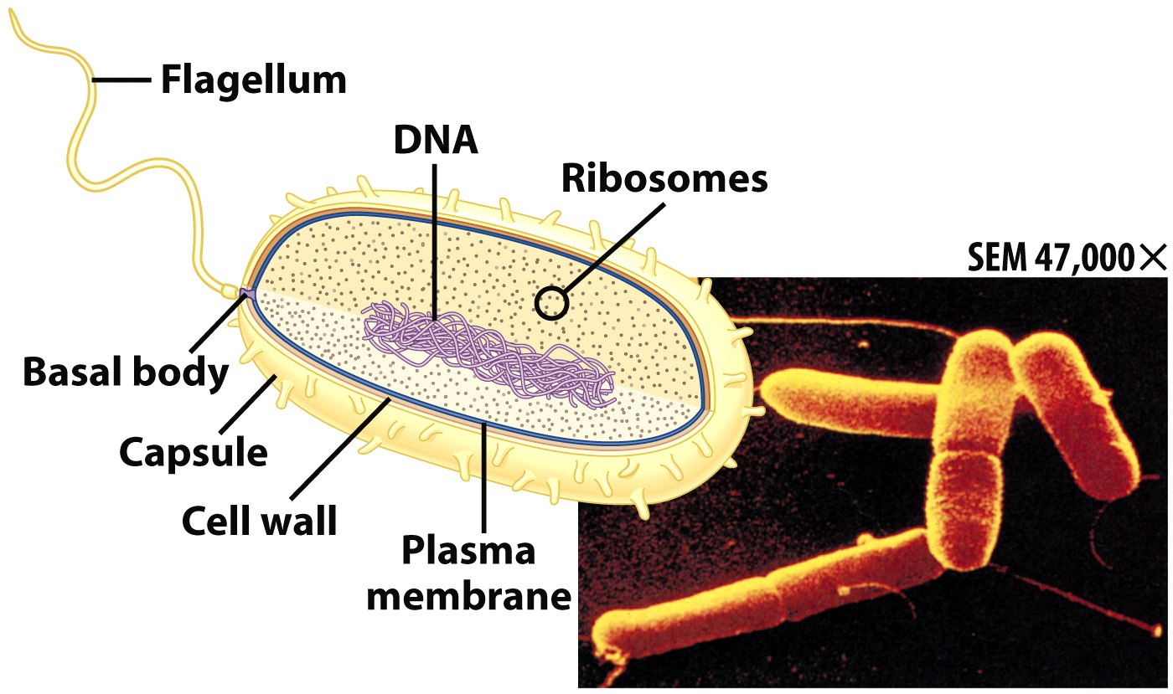
Prokaryotic Cells
First cell type on earth
Cell type of Bacteria and Archaea

Slide 11
Prokaryotic Cells
No membrane bound nucleus
Nucleoid = region of DNA concentration
Organelles not bound by membranes

Slide 12
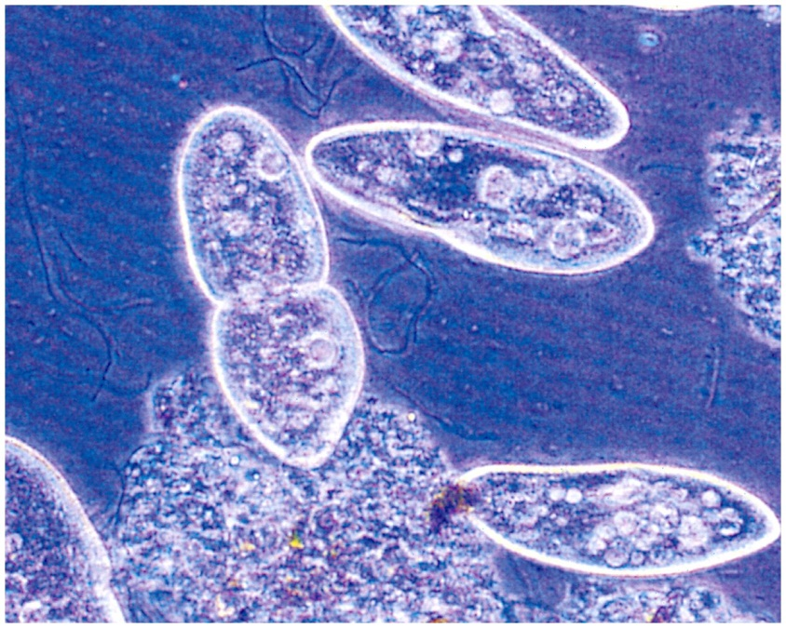
Eukaryotic Cells
Nucleus bound by membrane
Include fungi, protists, plant, and animal cells
Possess many organelles
Protozoan

Slide 13
Definition for eucaryotic and procaryotic cells?
Eukaryotic cells cell or organisms possess a clearly defined nucleus. They can be unicellular or multicellular.
Prokaryotes are unicellular organisms that lack membrane-bound structures, including the nucleus.

Slide 14
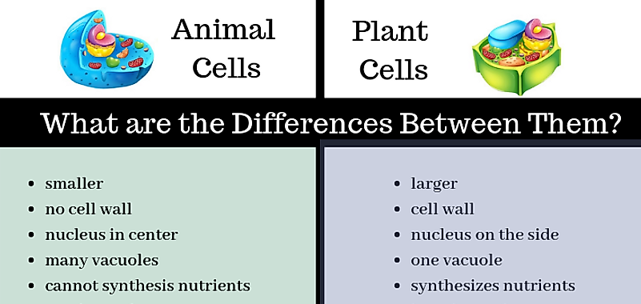
ICT - Plant and Animal cells
Create a list, table or draw a diagram highlighting some of the differences between Plant and animal cells.

Slide 15
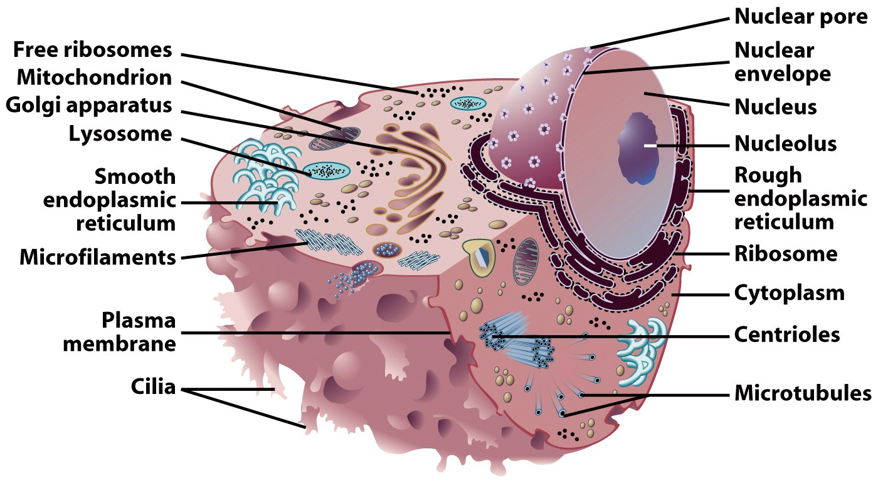
Representative Animal Cell

Slide 16
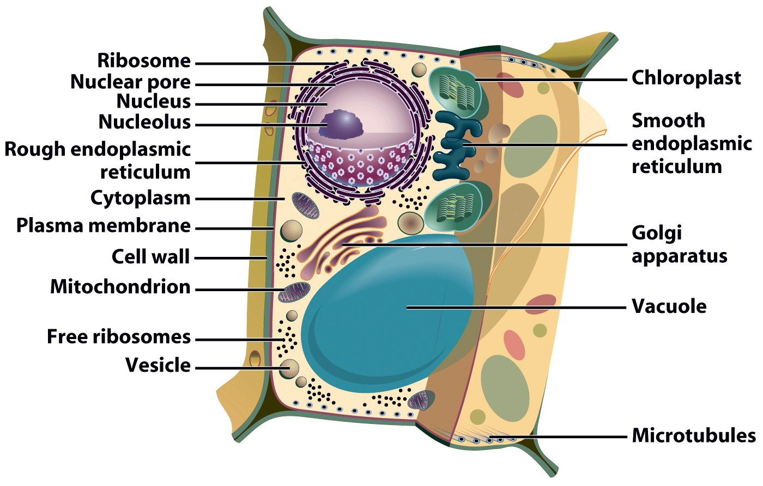
Representative Plant Cell

Slide 17
Think about
Part of the cell theory states that all organisms are composed of cells (and the products of cells). Explain what this means, giving examples.
What are the main differences between prokaryotic cells and eukaryotic cells?

Slide 18
Next Lesson
Cell Structure and function

